Slide 1

Fake News Detection System: An AI-Powered Web Application

Slide 2
The Challenge of Modern Misinformation
The Problem: In the digital age, misinformation and "fake news" spread rapidly through social media and online platforms. It is increasingly difficult for the average person to distinguish between credible journalism and fabricated content.
The Impact: This erosion of trust can influence public opinion, affect democratic processes, and cause social harm.
The Goal: To develop a simple, accessible tool that leverages Machine Learning to provide an instant authenticity check on news articles.

Slide 3

Our Project Goals
Full-Stack Web Application
We will create a web app with an intuitive frontend and a robust backend for reliability and ease of use.
Live News Integration
Our app will fetch real-time news articles using an API, ensuring users get current information.
Machine Learning News Classification
A machine learning model will automatically classify news articles as 'Real' or 'Fake' to improve credibility.
Cloud Deployment
The project will be cloud-deployable, making it easily accessible to the public from anywhere.
Notes:
Image source: Microsoft 365 content library We aim to develop a full-stack web application featuring a user-friendly frontend and reliable backend. The app will integrate live news by fetching real-time articles via an API. A machine learning model will classify news as 'Real' or 'Fake.' Finally, the entire project will be cloud-deployable for easy public access.

Slide 4
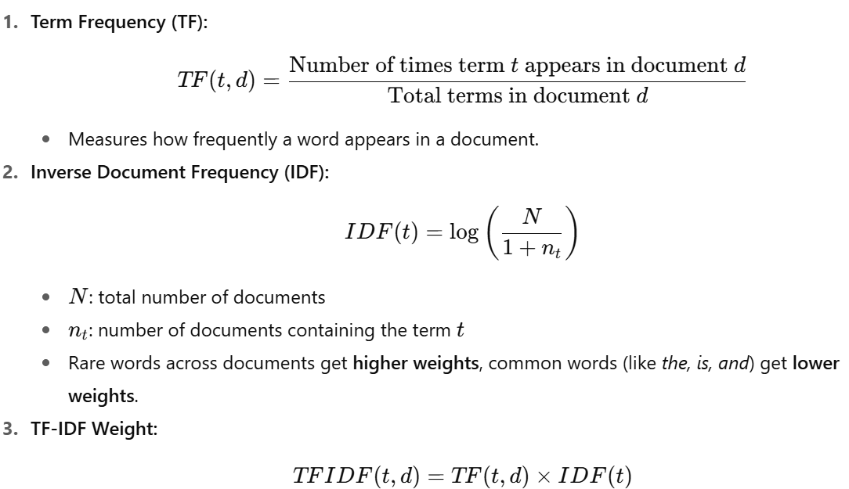
Working of Algorithm
Notes:
Image source: Microsoft 365 content library We aim to develop a full-stack web application featuring a user-friendly frontend and reliable backend. The app will integrate live news by fetching real-time articles via an API. A machine learning model will classify news as 'Real' or 'Fake.' Finally, the entire project will be cloud-deployable for easy public access.

Slide 5
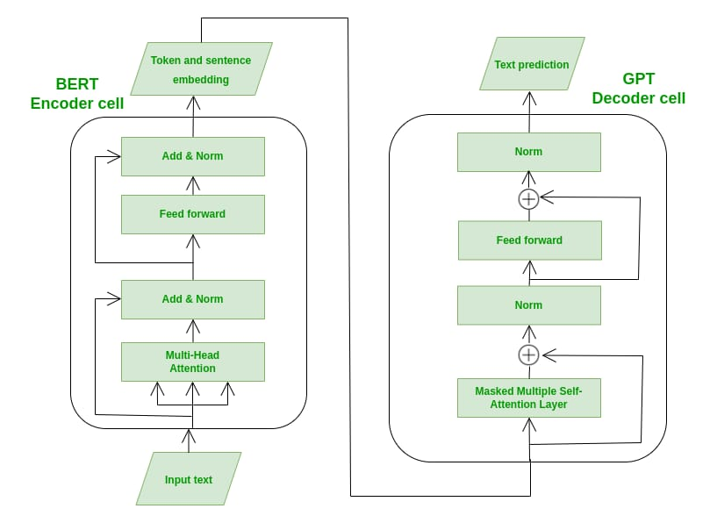
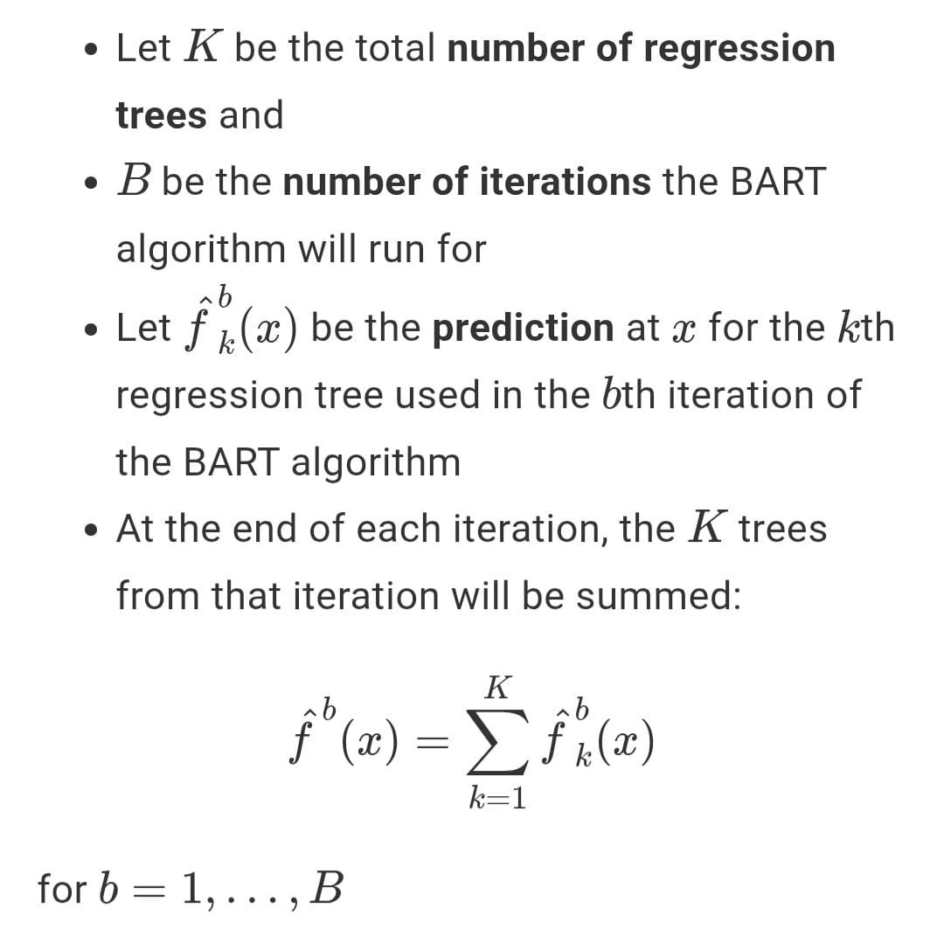
Working of Algorithm
Notes:
Image source: Microsoft 365 content library We aim to develop a full-stack web application featuring a user-friendly frontend and reliable backend. The app will integrate live news by fetching real-time articles via an API. A machine learning model will classify news as 'Real' or 'Fake.' Finally, the entire project will be cloud-deployable for easy public access.

Slide 6
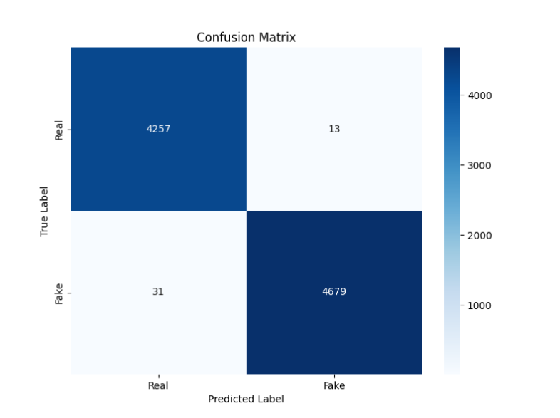
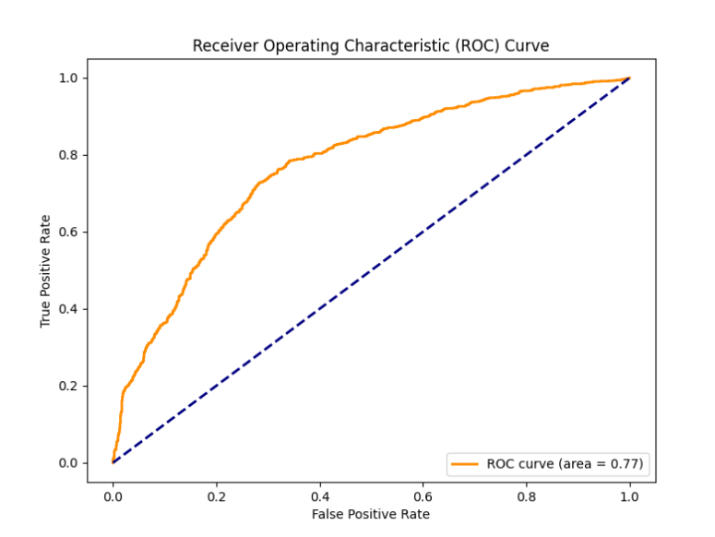
Confusion Matrix & Roc Curve
Notes:
Image source: Microsoft 365 content library We aim to develop a full-stack web application featuring a user-friendly frontend and reliable backend. The app will integrate live news by fetching real-time articles via an API. A machine learning model will classify news as 'Real' or 'Fake.' Finally, the entire project will be cloud-deployable for easy public access.

Slide 7
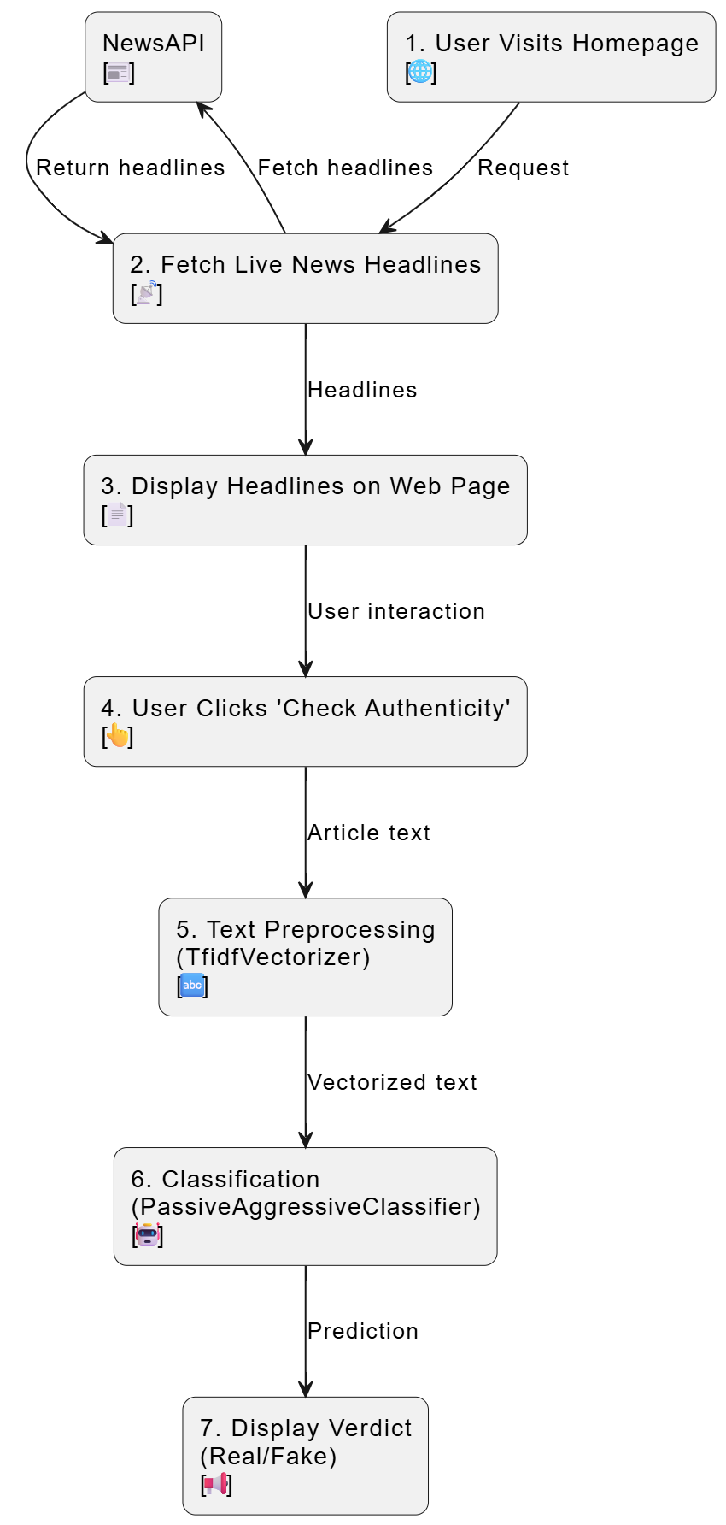
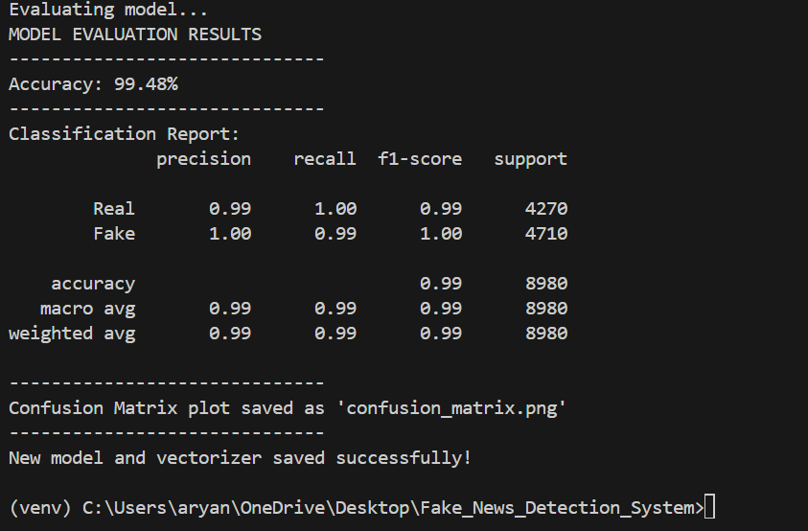
Architecture Diagram

Slide 8

Key System Components
Frontend Technologies
HTML5 structures the web pages, while CSS3 ensures responsive and visually appealing designs for all devices.
Backend Framework
Python powers the backend, using Flask for handling requests and Gunicorn for efficient deployment.
Machine Learning Core
Scikit-learn is used for classification tasks and Pandas manages and processes data within the system.
Deployment and Integration Tools
Deployment uses Render cloud platform, with News API for news and Git/GitHub for source code management.
Notes:
Image source: Microsoft 365 content library The frontend uses HTML5 for structure and CSS3 for responsive design. The backend is built with Python, utilizing Flask for request handling and Gunicorn for deployment. The machine learning core leverages Scikit-learn for classification and Pandas for data processing. Deployment relies on Render cloud platform, with NewsAPI for live news, and Git/GitHub for code management.

Slide 9

Inside the “Brain” of Classification
Text to Numerical Data
Text is transformed into numerical data using TF-IDF, BART, emphasizing significant words for effective classification.
Efficient Classification Algorithm
The Passive Aggressive Classifier algorithm is used for its speed and effectiveness in handling text classification tasks.
Learning News Patterns
Training on a custom dataset enables the model to distinguish between fake and real news patterns.
Notes:
Image source: Microsoft 365 content library Machine learning models process text by converting it into numerical data using TF-IDF, which highlights important words for classification. The PassiveAggressiveClassifier algorithm, chosen for its efficiency in text tasks, learns to identify fake and real news patterns by training on a custom dataset. This approach enables accurate, speedy news categorization.

Slide 10

From Click to Classification
Fetching Live News Articles
Flask retrieves current articles from News API and displays them on the website’s homepage for user interaction.
Article Content Transformation
The backend converts article text into numerical vectors using Tfidf Vectorizer, preparing the data for machine learning analysis.
Automated Authenticity Prediction
A Passive Aggressive Classifier evaluates the article’s authenticity, enabling fast and reliable real or fake news classification.
Notes:
Image source: Microsoft 365 content library The user visits the site, prompting Flask to fetch live articles from NewsAPI. Articles appear on the homepage where the user clicks 'Check Authenticity.' The backend translates the article text into numerical data using TfidfVectorizer, then predicts authenticity with a PassiveAggressiveClassifier. Finally, Flask displays a clear verdict: 'Real News' or 'Fake News.'

Slide 11

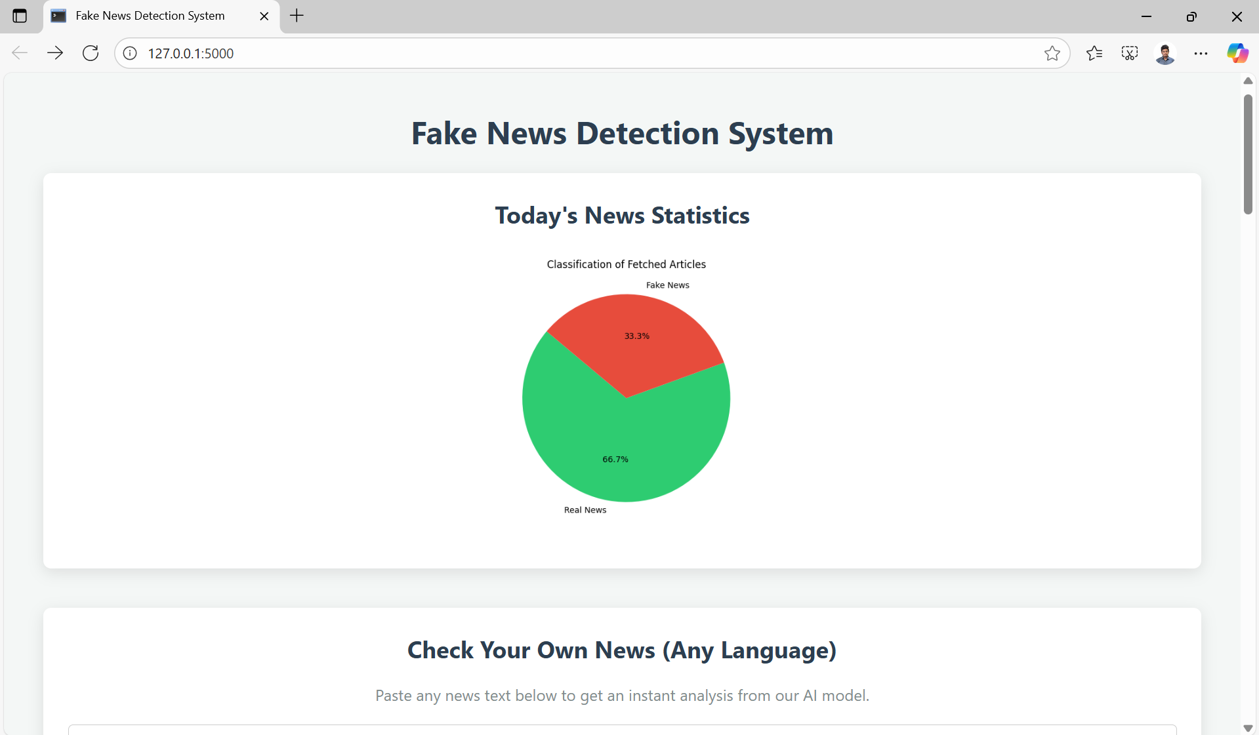
See It in Action
Live Demo Experience
Users can try out the application directly through an accessible live demo, experiencing its features in real time.
Showcase of Core Features
The deployed version highlights all main functionalities, offering a comprehensive view of the application's capabilities.
Real-Time Interaction
Users can engage with the system instantly, exploring how the application responds to their inputs.
Scan this to use in your phone
Notes:
Image source: Microsoft 365 content library Experience the application firsthand through our live demo, which is publicly accessible online. The deployed version showcases all core features and allows users to interact with the system in real time. Explore the application’s capabilities by visiting the provided Live Demo Link.

Slide 12

Overcoming Challenges, Shaping Future
Current Limitations
Challenges include a limited dataset, potential bias, poor sarcasm detection, and API rate restrictions affecting performance.
Expanding and Improving Data
Future steps include enlarging the dataset with trustworthy sources to reduce bias and improve overall accuracy.
Advanced Models and Feedback
Adopting new models like LSTM or BERT and utilizing user feedback will boost adaptability and linguistic understanding.
Notes:
Image source: Microsoft 365 content library Current hurdles include a small, potentially biased dataset, the difficulty in detecting linguistic nuances like sarcasm, and API rate limitations. Looking ahead, improvements involve expanding the dataset with reputable sources, adopting advanced models such as LSTM or BERT, and integrating user feedback to enhance accuracy and adaptability.

Slide 13

Summary of Key Achievements
Full-Stack Application Development
Designed and built a complete web application, covering frontend, backend, and deployment from scratch.
AI-Powered News Classification
Integrated a machine learning model to classify real-world news, enhancing the application's practical utility.
End-to-End Project Execution
Completed all project phases: data preparation, model training, and cloud deployment for real-world impact.
Notes:
Image source: Microsoft 365 content library Successfully designed, built, and deployed a full-stack web application from the ground up. Integrated a machine learning model for real-world news classification, enhancing practical value. Demonstrated a complete project lifecycle, including data preparation, model training, and cloud deployment, showcasing AI’s potential in combating misinformation.

Slide 14
THANK YOU

